Slide 1
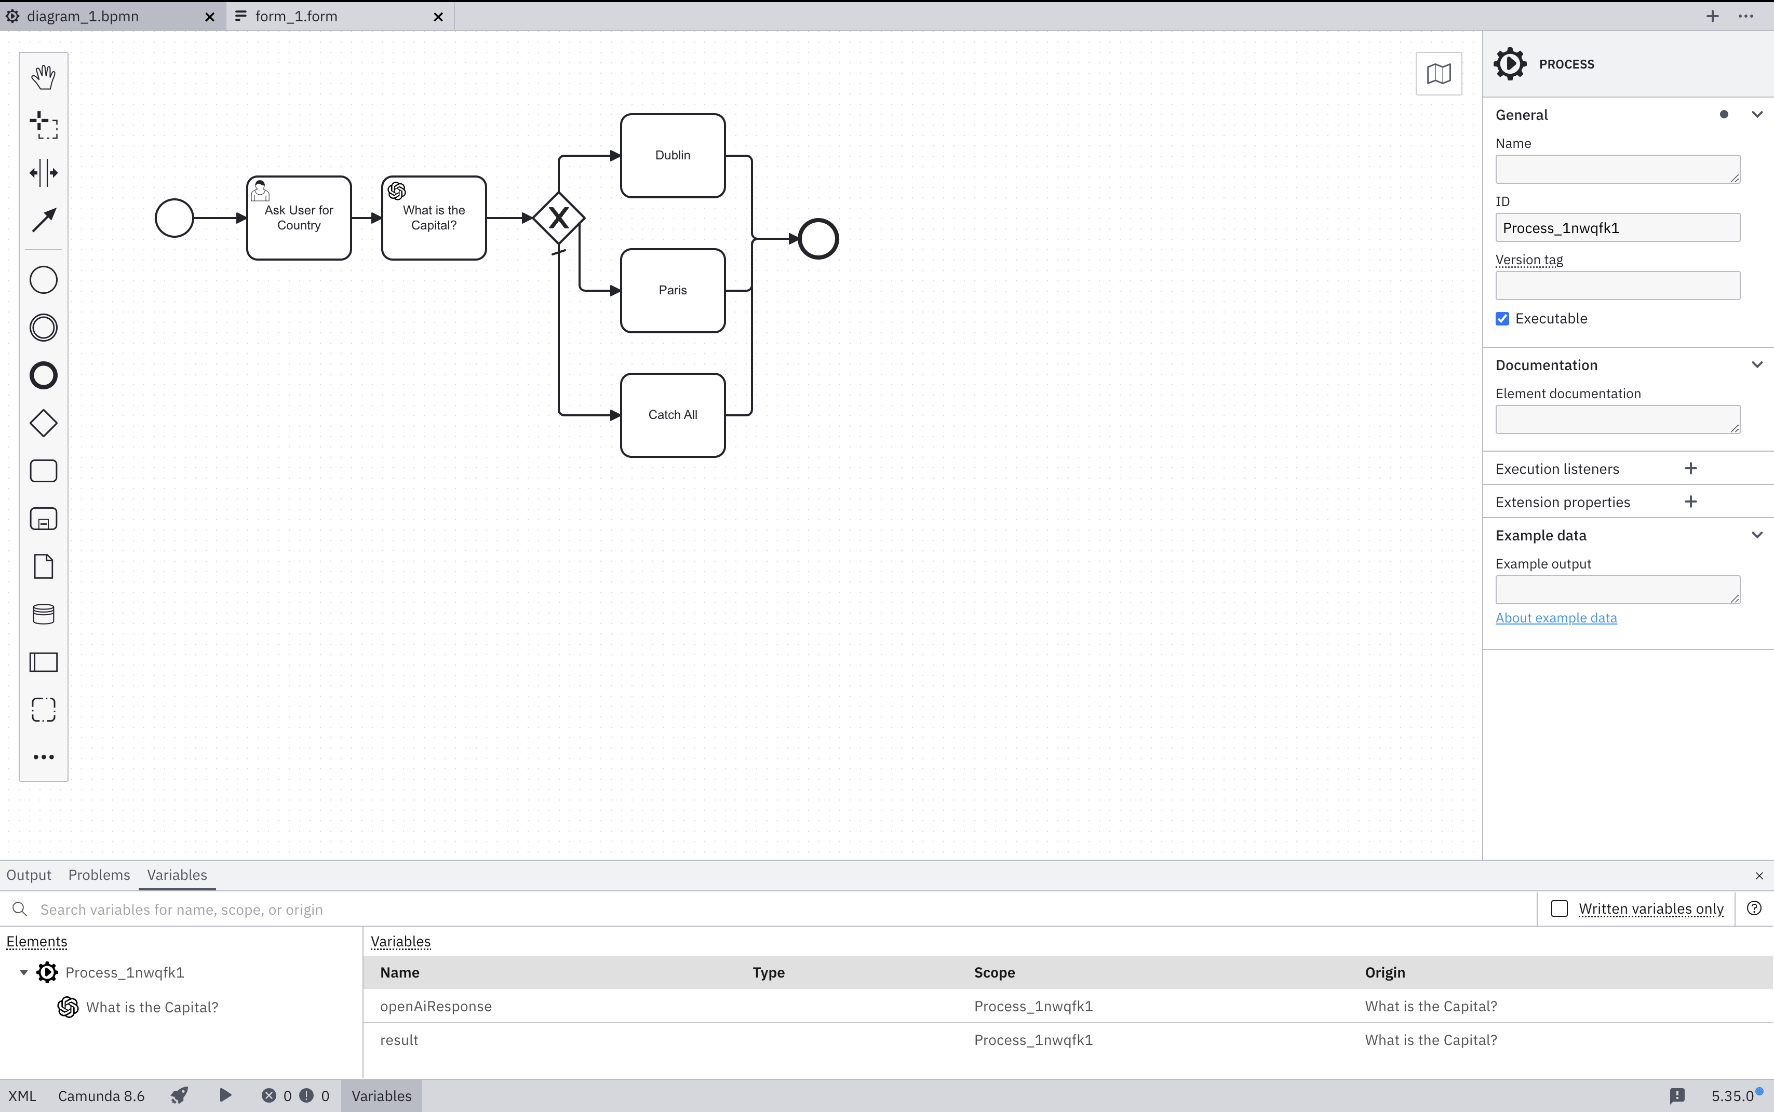
4. Models essentially consist of events (circles), tasks (rectangles), decisions (diamonds) and connections (lines).
1. There is where you can load the exercises and create new files
5. Events are used to represent triggers, results, errors, etc.
6. Tasks are where the action is, and the types of tasks are presented by the top/left images. For example, a person is user actioned, and a ChatGPT logo refers to an AI automation.
3. Create and place new objects
2. First up, ensure the right + bottom menus have been expanded, so you can see what is going on
7. The decisions (aka gateways) represent forks in the road. X means it needs to exclusively go down only 1 path, but there is also parallel processing for example. The connections around these include data and rules of when to navigate the paths. Also notice the “forward slash” on one of them, which means this is the default flow.
8. Where you can start the process

Slide 2
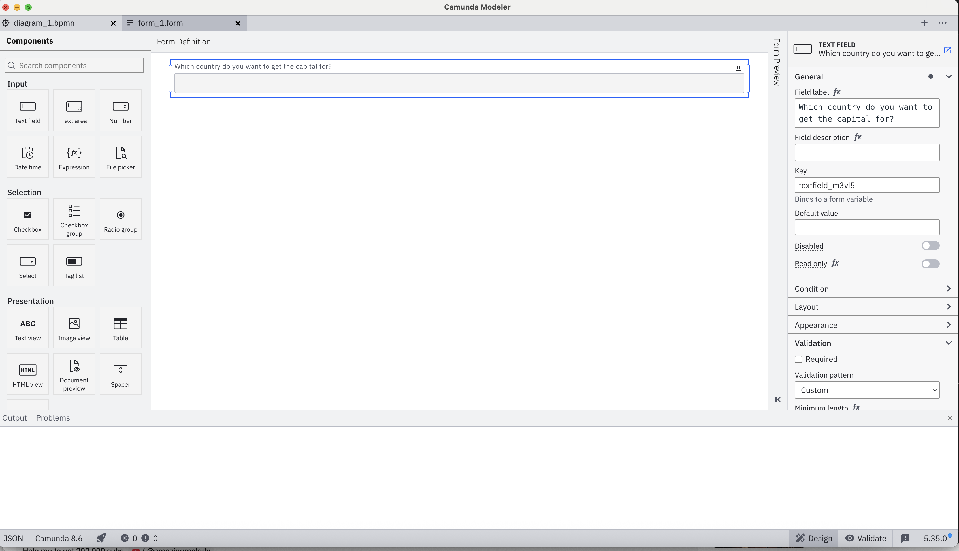
2. Form layout
3. Component configuration
1. Components to utilise in your forms
4. Preview the resulting JSON.

Slide 3
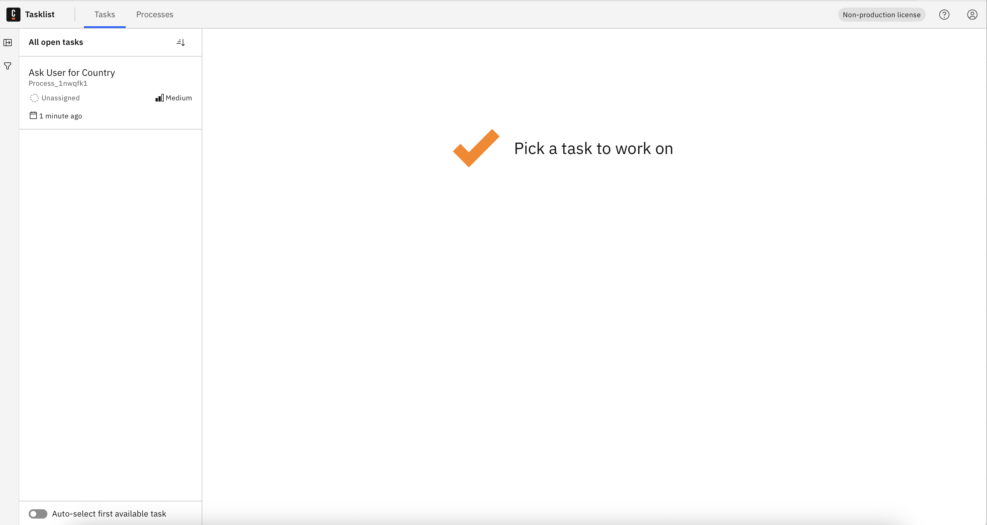
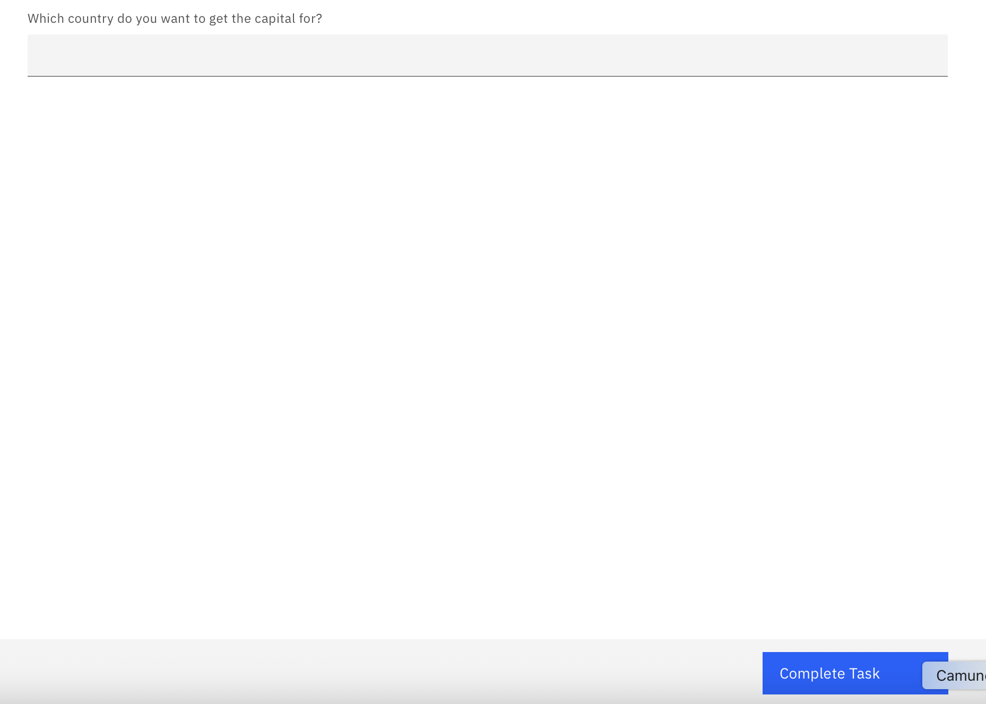
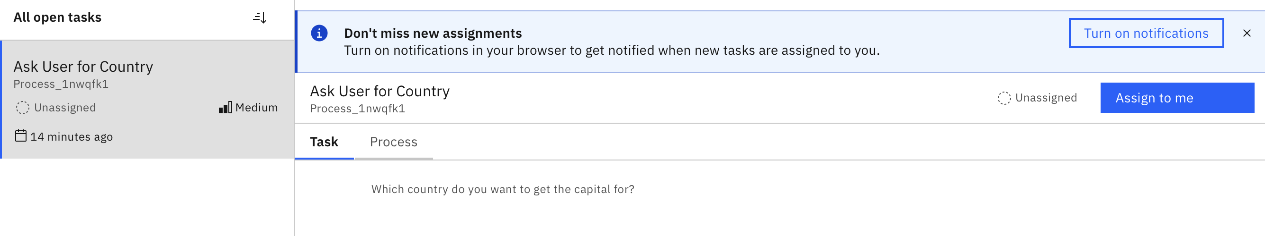
http://localhost:8080/tasklist
1. List individual tasks or tasks grouped by process
5. Then complete all fields and click “Complete Task”
2. Additional filters to quickly find specific items
3. Task name / associated process and key info
4. Once you click on the task, click on ”Assign to me”

Slide 4
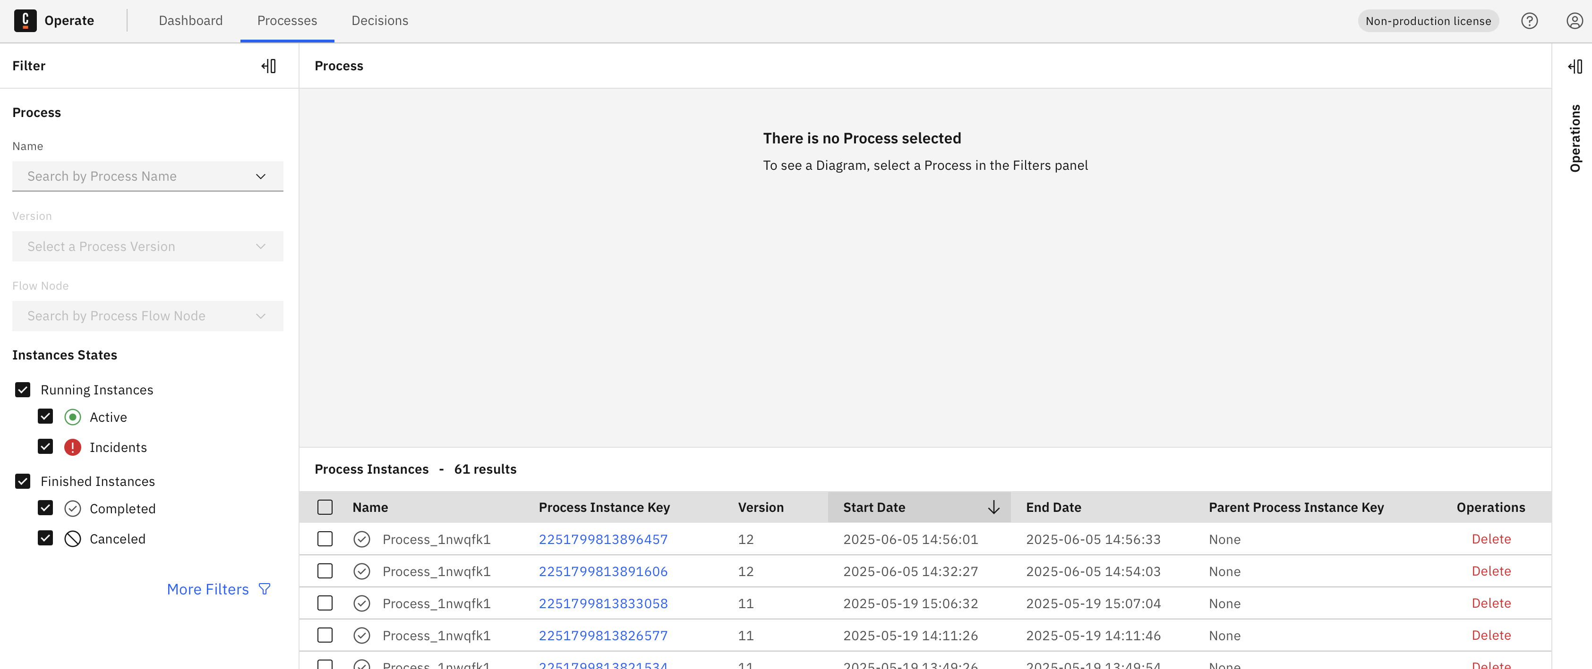
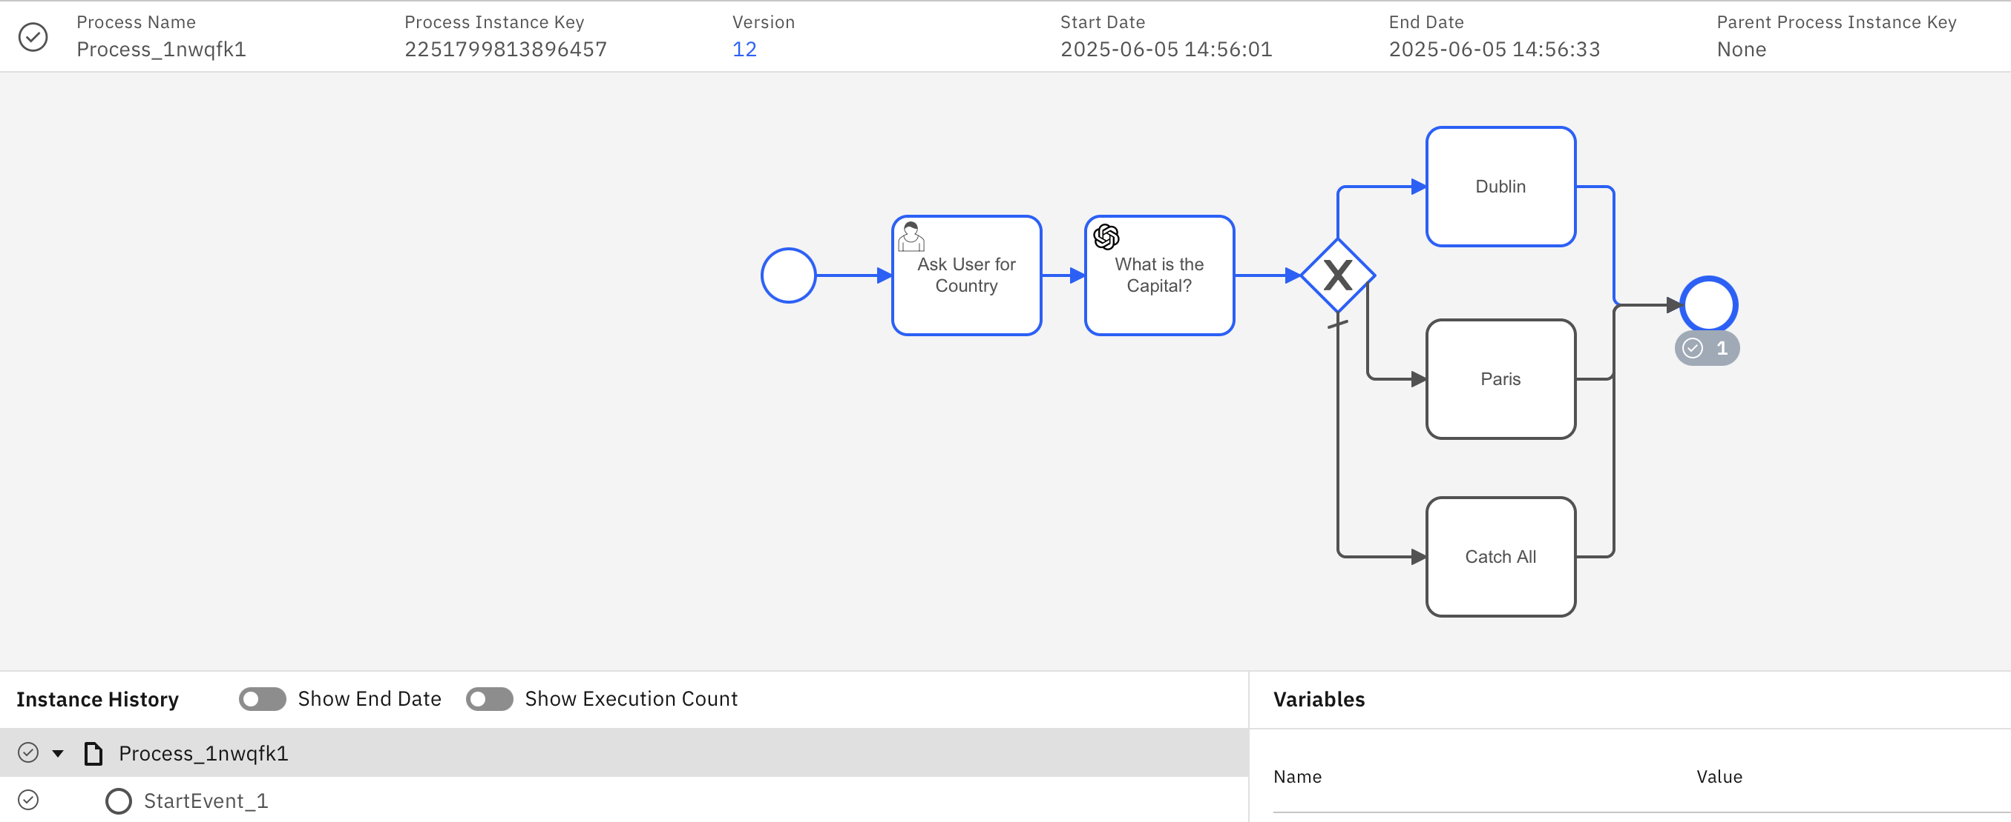
http://localhost:8080/operate
1. Select your preferred perspective. I personally like “Processes”
4. These are the process version details. Also, the blue line highlights where the process currently is and what path it took.
3. Click on a process ID to see the current transaction details.
2. Tick “Finished Instances” to view processes that have already completed.

Slide 5
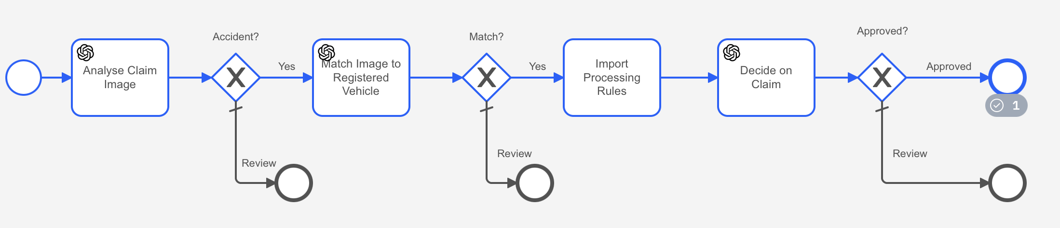
1. Vision AI
2. Combination of Natural Language Processing (NLP) + Gen AI
3. Business Rules
4. Decision Automation

Slide 6
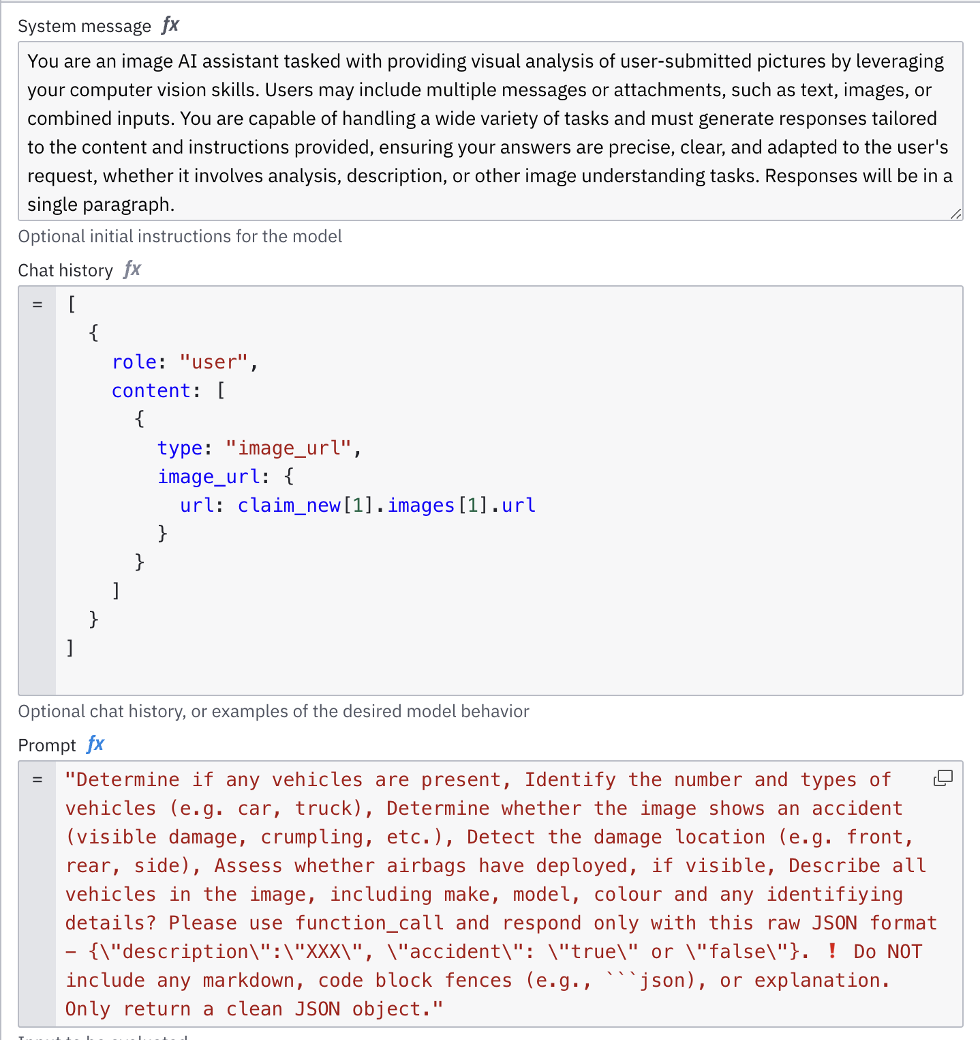
The system message is important as it prepares the AI for the kind of question you will ask and how it should handle it.
Prior to your actual question, you sometimes need to provide context. Chat history is a great way of providing key data.
Prompt is where you ask your actual question. I have found it is important to also say how & how not the AI should respond.

Slide 7
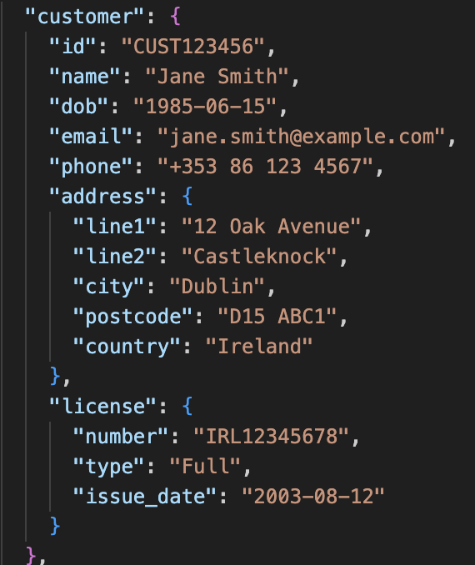
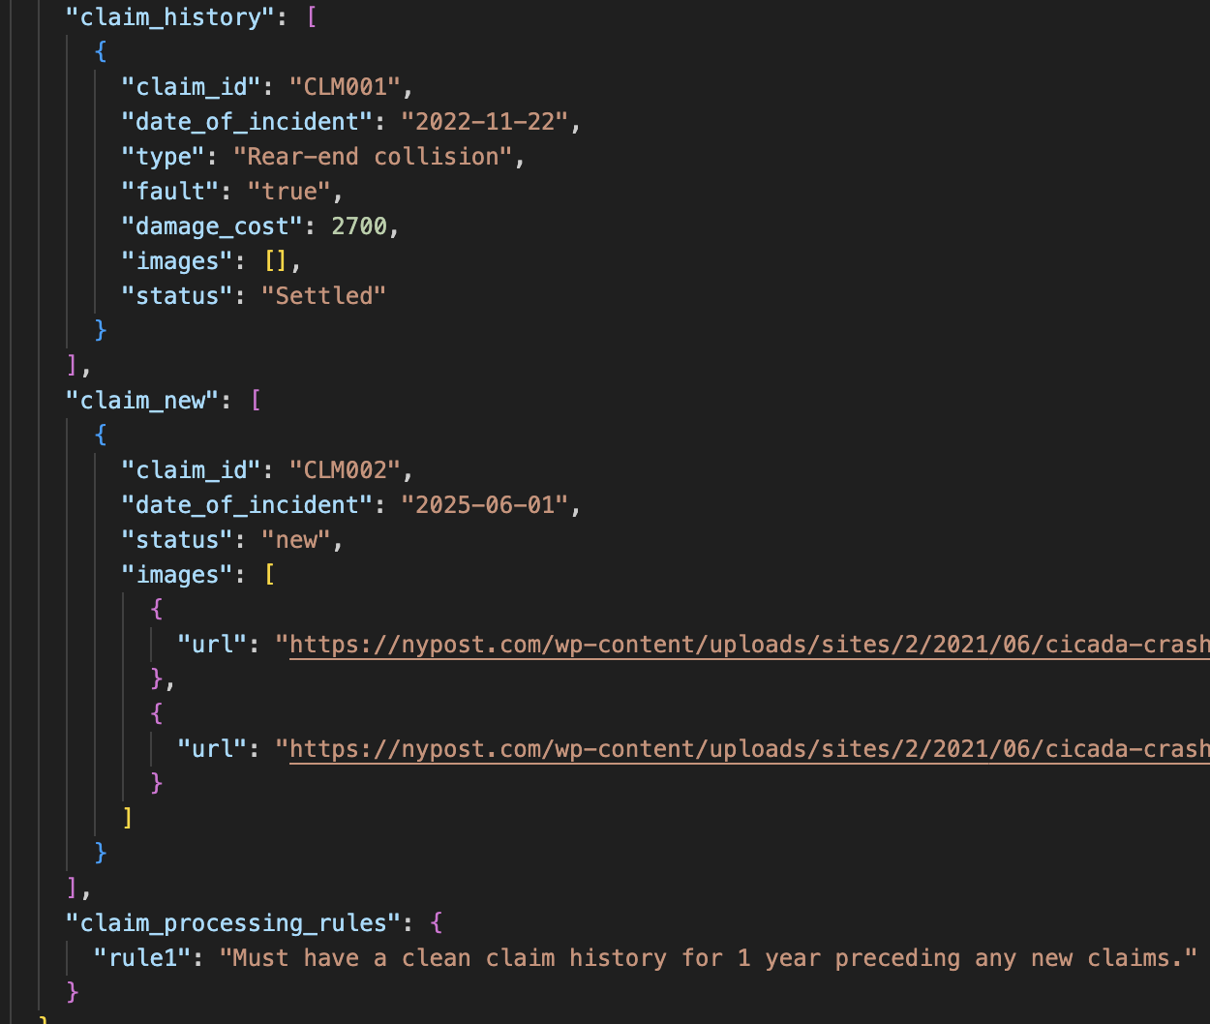
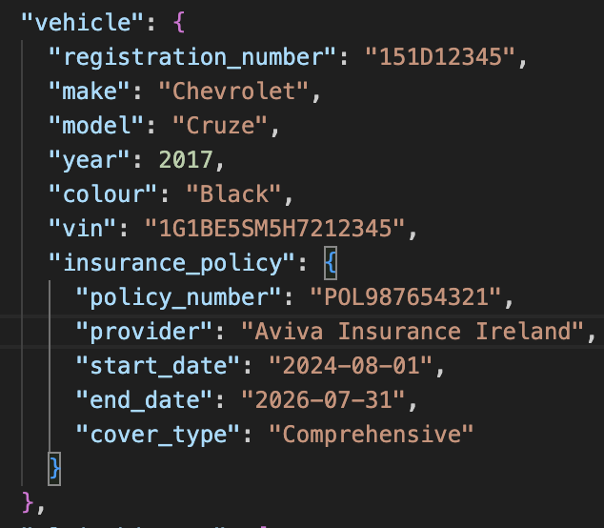
CUSTOMER. E.g. If you changed the license type to cancelled would impact the claim
CLAIMS. Both current and historical
VEHICLE. E.g. changing the car colour, or policy dates / cover-type would impact approval.
BUSINESS RULES. E.g. You can create your own using natural language. Try change 1 year to 10 and seeing what happens.

